Slide 1
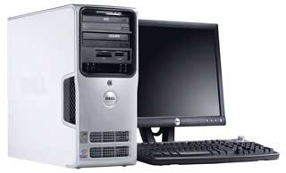
Parts of a computer.
Disk Drives
Peripherals
CPU

Slide 2
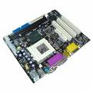
Motherboard
The motherboard is the centre of the computer, it controls everything that happens and all peripherals plug in to it.
The motherboard houses the hard drive, the graphics card, the CPU, the RAM chips and the monitors plug in to it.

Slide 3
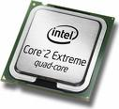
CPU
The CPU is the Central Processing Unit, the brain of the computer.
It does the calculations and the sorting.
CPUs have little clocks in them. The more these clocks tick the more it can do at once.
Its speed is measured in Gigahertz (GHz).

Slide 4
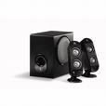
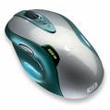
Peripherals
A device that connects to a computer.
Keyboard, mouse, printer, scanner, speakers, external hard drives.

Slide 5
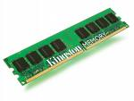
Memory
Memory is Random Access Memory, also called RAM.
The RAM sticks fit into slots on the motherboard.
Most computers now come with 2, 3 or 4 GB RAM, but many of them can support more if there are enough slots - Apple Macs can support up to 32GB!

Slide 6
Software
Software are the applications and programming instructions needed to make the computer do useful work.
System software is for example the operating system.

Slide 7
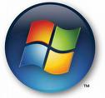
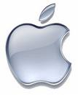

Operating Systems
The operating system (OS) is software.
Common operating systems are:
Microsoft Windows (XP, Vista, 7) and Apple Mac OS X.
There are alternatives such as GNU/Linux – there are many diferrent distributions, some common ones include Ubuntu, Fedora and Debian. The one main advantage is that most distributions are free of charge – it’s part of the GNU/Linux philosophy.

Slide 8
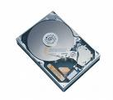
Disk Drives
The hard drive is where all the data is stored. It has disks in it covered with film that move and are very sensitive – if dust gets on the disks everything can be destroyed, that is why it is securely fastened.
Other disk drives include floppy disk drives, CD drives, DVD drives and

